Slide 1
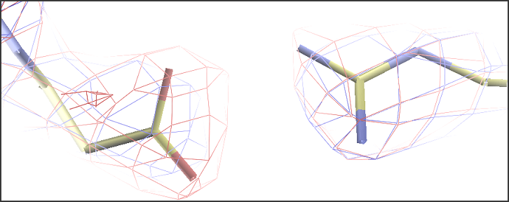



How good is my model? Can I improve it?
And how do I share it with the community?
Robbie P. Joosten
Netherlands Cancer Institute
CCP4-DLS school 2024

Slide 2
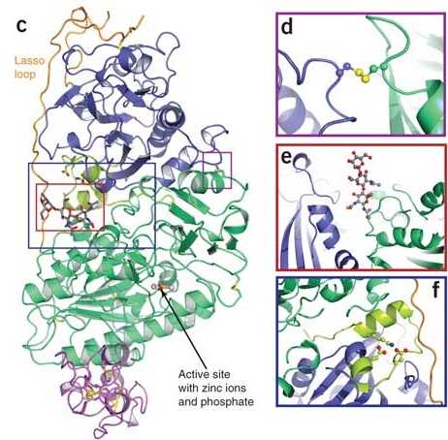
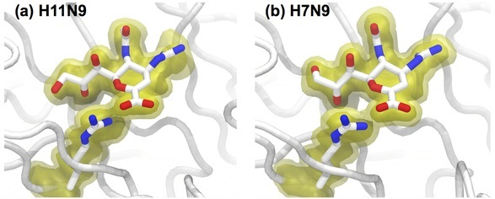
We want to know...
What are a protein’s function and mechanism?
How can we manipulate them?
We need the best possible model to answer these questions

Slide 3
Is my model as good as it can be?
Use validation when making the model
  Check model vs. data and vs. prior knowledge
  Focus on outliers (fix or explain them)
  Know the things that can go wrong
Optimise the model
  Focus on what can be improved
  Choose best refinement parameters and restraints
  Rebuild parts of the model
  PDB-REDO automates this
Deposit and publish the model
  Quality of the model description and annotation

Slide 4
Validation

Slide 5


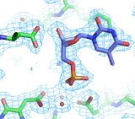
Need to know
Check the validity and value of a model
  Accuracy and precision
Many different software tools
  General: MolProbity, PDB validation server
  Non-protein: CheckMyMetal, Privateer, DNATCO
  Tools may check the same things differently
Not a substitute for common sense
  False positives do occur
  Conflicting results
  Not all problems are detected (explicitly)

Slide 6
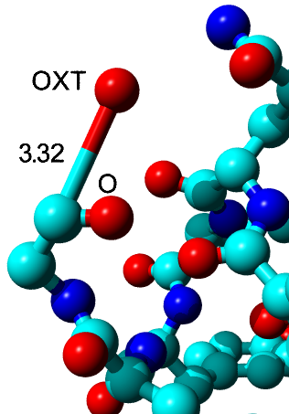
Bonds and angles
Individual outliers
  Usually fitting errors
  Express deviation in terms of SD (Z-scores)
  Example: Z = 105
Large overall deviations from ideal values
  Express as rmsZ, not rmsd
    Should be < 1.000
  Use tighter restraints

Slide 7
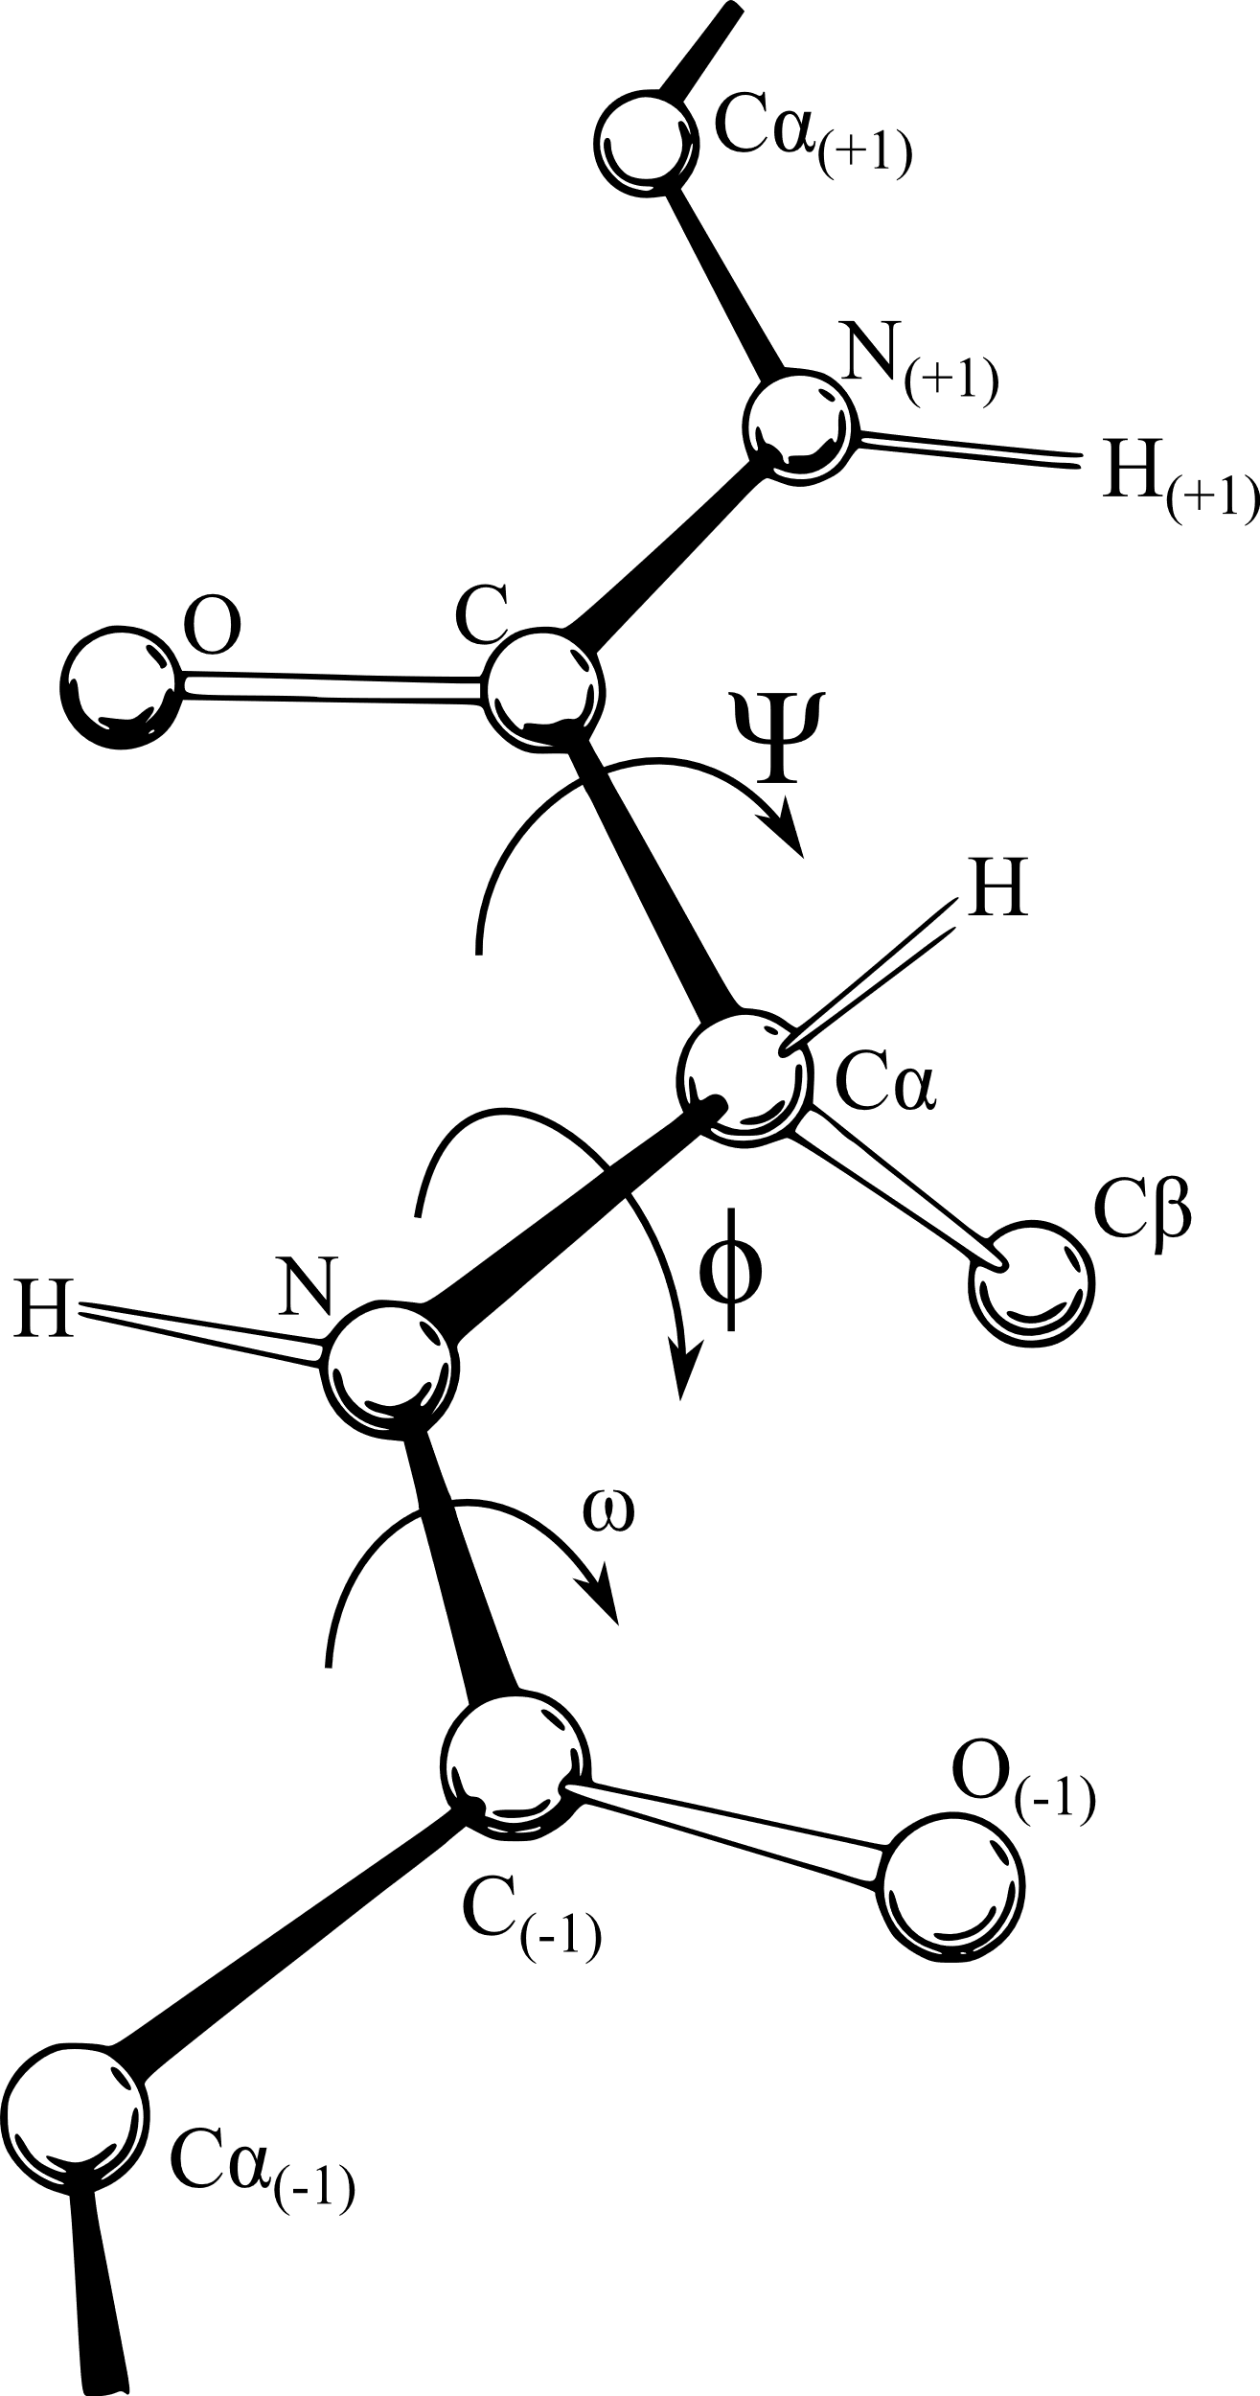
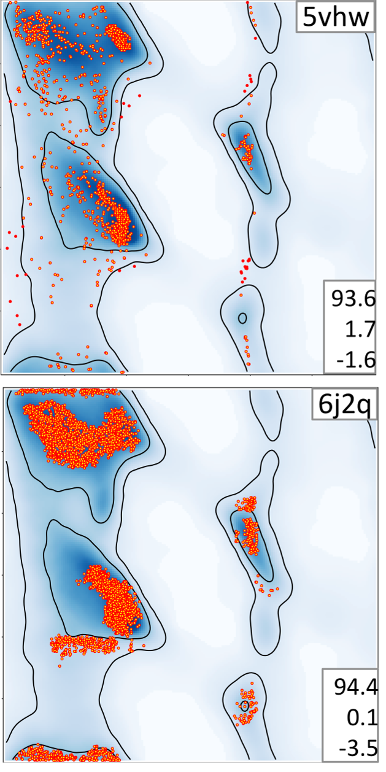
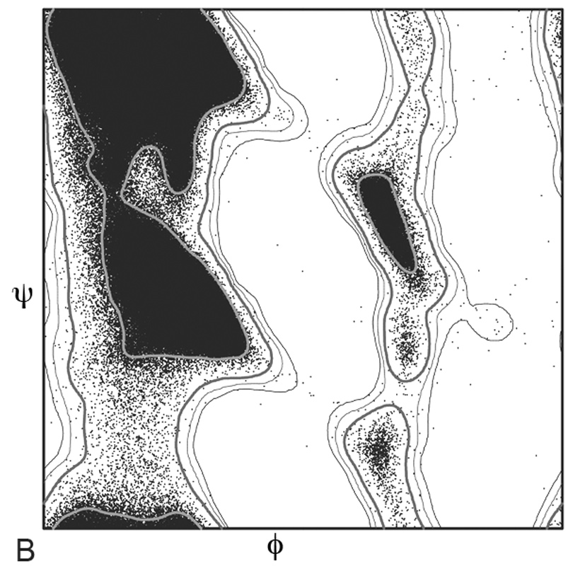
Backbone torsion angles
Ramachandran plot
  φ and ψ angles
  Not all conformations are possible
  Compare to the whole PDB or a subset
Different implementations
  MolProbity and COOT: preferred, okay, outlier
    Good for finding specific individual problems
    Check severity of outlier on the plot
  Tortoize, MolProbity, Phenix: whole plot Rama-Z
    Good for checking building and refinement progress
    Sensitive to over-restraining

Slide 8
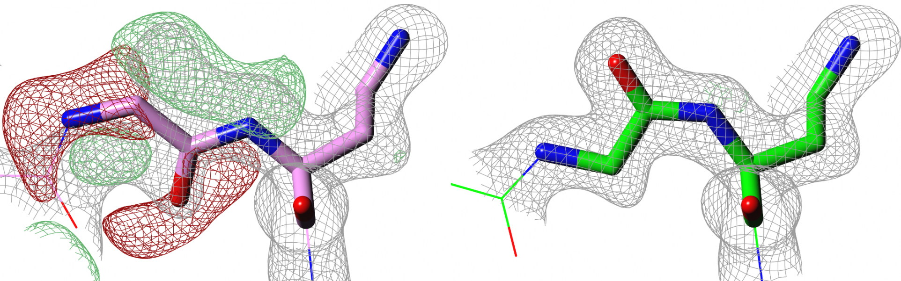
Backbone torsion angles
Peptides are flat
  ω angle is ~180° (trans) or ~0° (cis)
  Fitting errors or the wrong restraints cause outliers
    COOT treats all peptides as trans by default

Slide 9
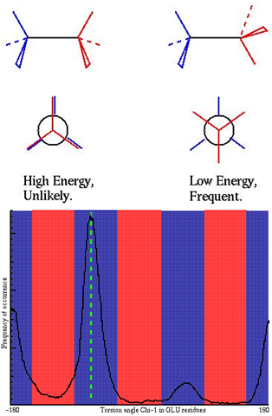
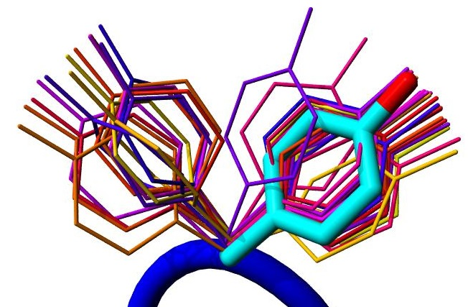
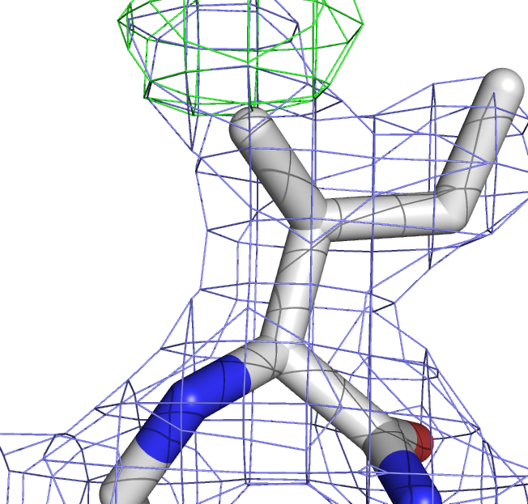
Side chain torsion angles
Steric hindrance causes discrete rotamers
Check against (backbone specific) distributions from the PDB
Outliers are fitting errors or false positives

Slide 10
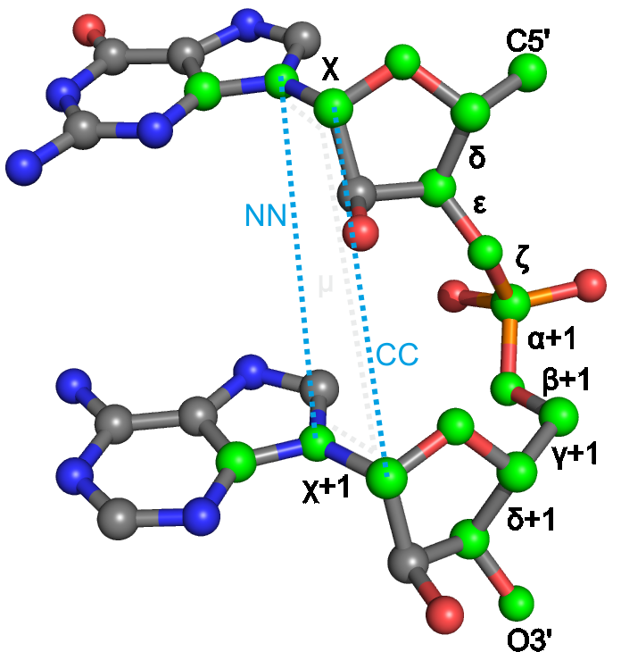
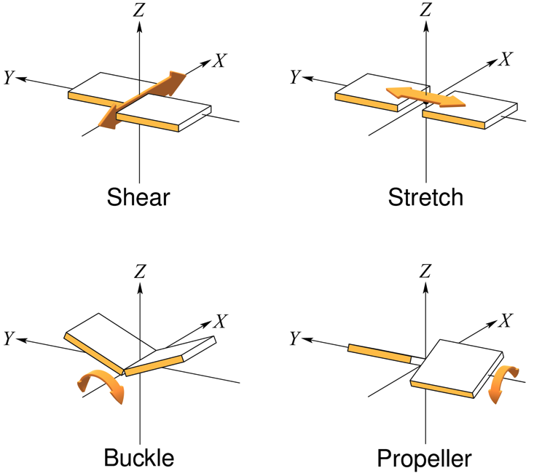
DNA and RNA
Too many torsions to do Ramchandran-like things
  MolProbity does conformational ‘suites’ (RNA only)
  DNATCO used pairs of sequential residues
    Conformation normality score CONFAL
Base pairs also have conformations
  PDB-REDO calculates normality of relative base orientation in Watson-Crick base pairs
    Single Z-score per parameter, DNA/RNA-specific
  Individual Z-scores are combined to overall Z_{bpG}
    rmsZ score for the whole structure model
  Will be extended to a broader set of base pairs

Slide 11
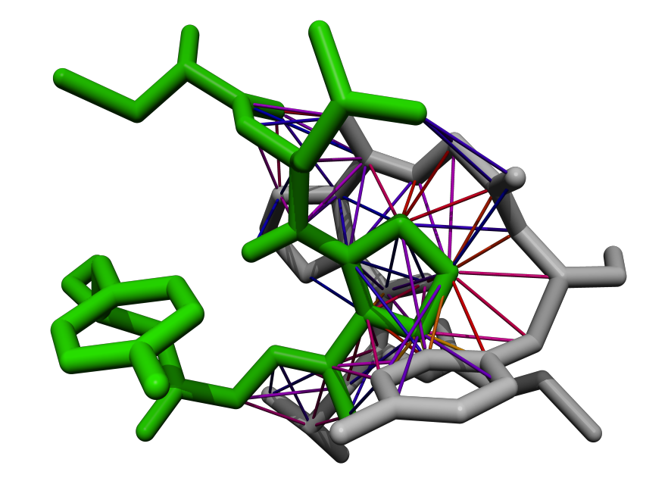
Bumps/clashes
Two atoms cannot occupy the same space
Average PDB entry > 100 bumps
Bumps vary in severity
  Mild bumps can be fixed by refinement
  Severe bumps typically require rebuilding
Don’t forget about symmetry
  Keep it switched on in COOT
Normal contact Mild bump Severe bump

Slide 12
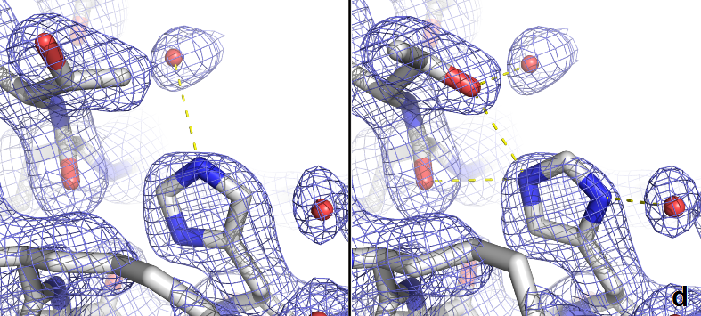
Hydrogen bonds
Asn, Gln, and His flips
  Detected by PDB-REDO, MolProbity & COOT
  Also use common sense
Buried unsatisfied H-bond donors and acceptors mark (subtle) errors
  Use environment distances in COOT
  Check your Arginines
Waters should also make H-bonds
  3b3q has > 250 waters without H-bonds

Slide 13
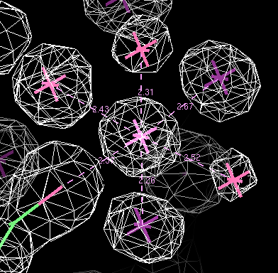
Metal ions
Light metal ions are easily overlooked
  Water, Na⁺, and Mg²⁺ have same number of electrons
Detect and validate with COOT, Phenix, CheckMyMetal
  All use the Bond Valence method
  Depends on coordination distances
    Be careful with restraints
  Very different results

Slide 14


Metal ion identification and validation
Use anomalous maps
Use wavelength scan from synchrotron
Keep your crystallisation conditions in mind
Check site geometry with in MetalPDB
If it is really important, do more experiments
Validate metal site with CheckMyMetal

Slide 15
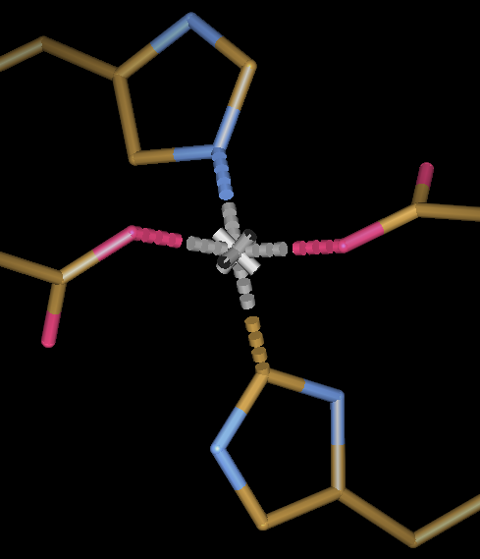
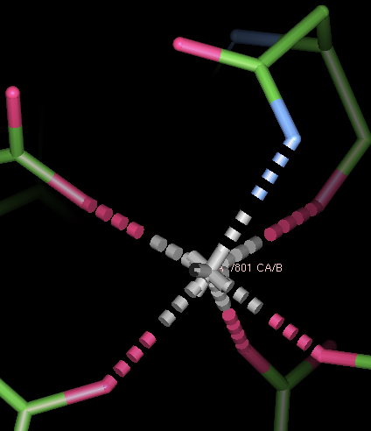
Metal ions
Na, Mg, K, Ca prefer being coordinated by oxygen atoms
  Flip Asn or Gln side chains if needed
Carbons usually do not coordinate metals
  Flip His side chains if needed
  Cyanide and carbon-monoxide are exceptions
Notes:
pdb1hfe.ent:LINK CE1 HIS S 82 ZN ZN S 500

Slide 16
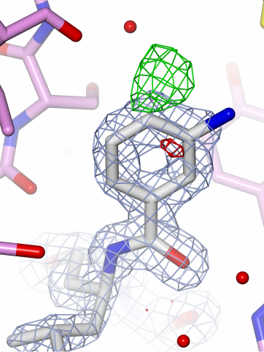
Ligands
Building and validation steps:
Is something there?
  Check the (difference) density
Is it my ligand?
  Check contacts
  Remember crystallisation conditions
  Check the density in detail
Is the geometry sensible?
  First check the restraints themselves
    Don’t forget about chirality
  Then check model against restraints

Slide 17
Validation is a lot of work, but it helps you make better models

Slide 18
Model optimisation = making choices
Refinement settings
  Restraints and weights (geometry, B-factors, homology, jelly body)
  Solvent model
  High resolution cut-off
  Special cases (NCS, twinning, occupancies)
Number of model parameters
  B-factor model
  Number of TLS models
Structure model
  Main chain
  Side chains
  Hetero compounds
Automation speeds up optimisation

Slide 19
PDB-REDO
Pipeline for X-ray & electron crystallography
  Fully automated expert system
  Refines, rebuilds, and validates your model
Well-tested and high-throughput
  Run on the entire PDB
  Databank with weekly updates (pdb-redo.eu)
Available as webserver and through CCP4
  1900 active users
Model, X-ray data, sequence
Parametrisation
Refmacat refinement
Rebuilding
Refmacat refinement
Model validation
PDB-REDO model and data

Slide 20
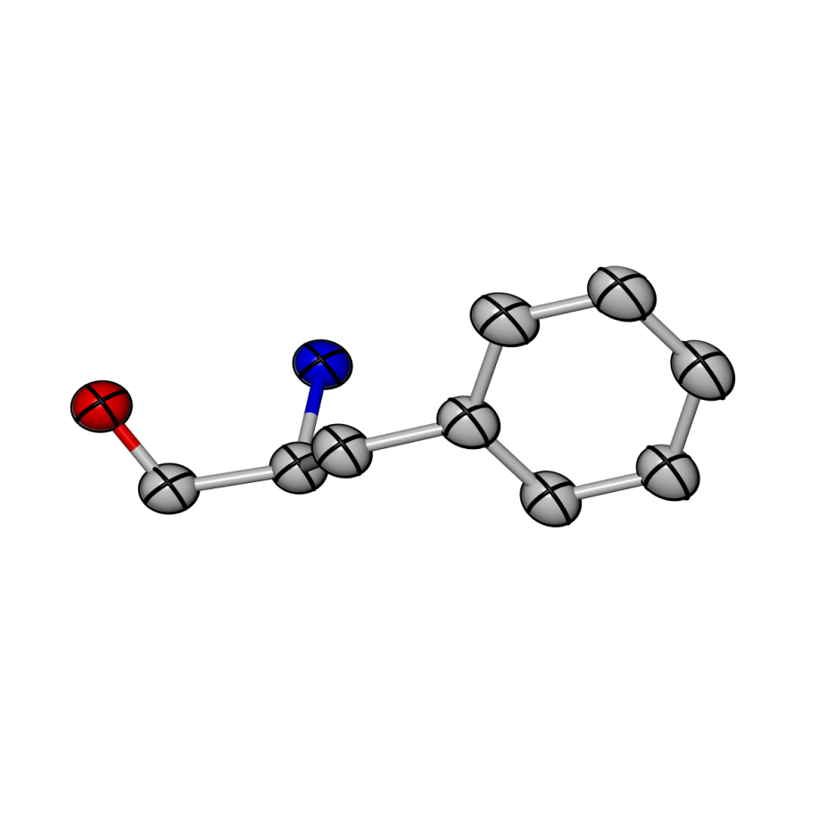
Features and algorithms
Methods
NCS and twinning treated automatically
  Warns for space group errors
Establish high resolution cut-off through paired refinement
B-factor model selection:
  Refine alternative models and select best one
    Isotropic, anisotropic, or flat B-factors
    One TLS group per chains, user-provided model, or no TLS
Grid searches:
  Optimise solvent mask parameters
  Select weights for geometric and B-factor restraints

Slide 21
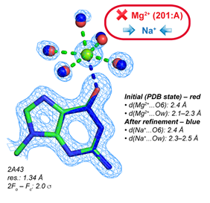
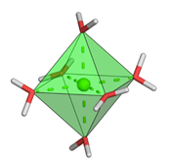
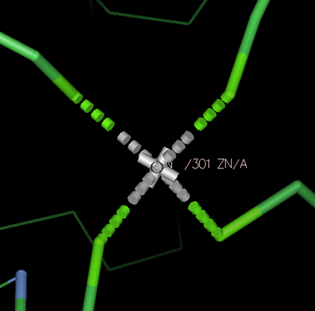
Features and algorithms
Methods
Case specific restraints:
  Jelly-body restraints (low-ish resolution)
  Zinc sites (all structural zinc sites)
    Many distorted sites in the PDB
    Solution from platonyzer: cleaned set of restraints
  Octahedral Sodium and Magnesium sites
    Can only be distinguished by coordination distance
    Distance biased by restraints, but restraints are needed
    Solution: use angle restraints to define an octahedron
      18 angle restraints per site, no distance or VdW restraints

Slide 22
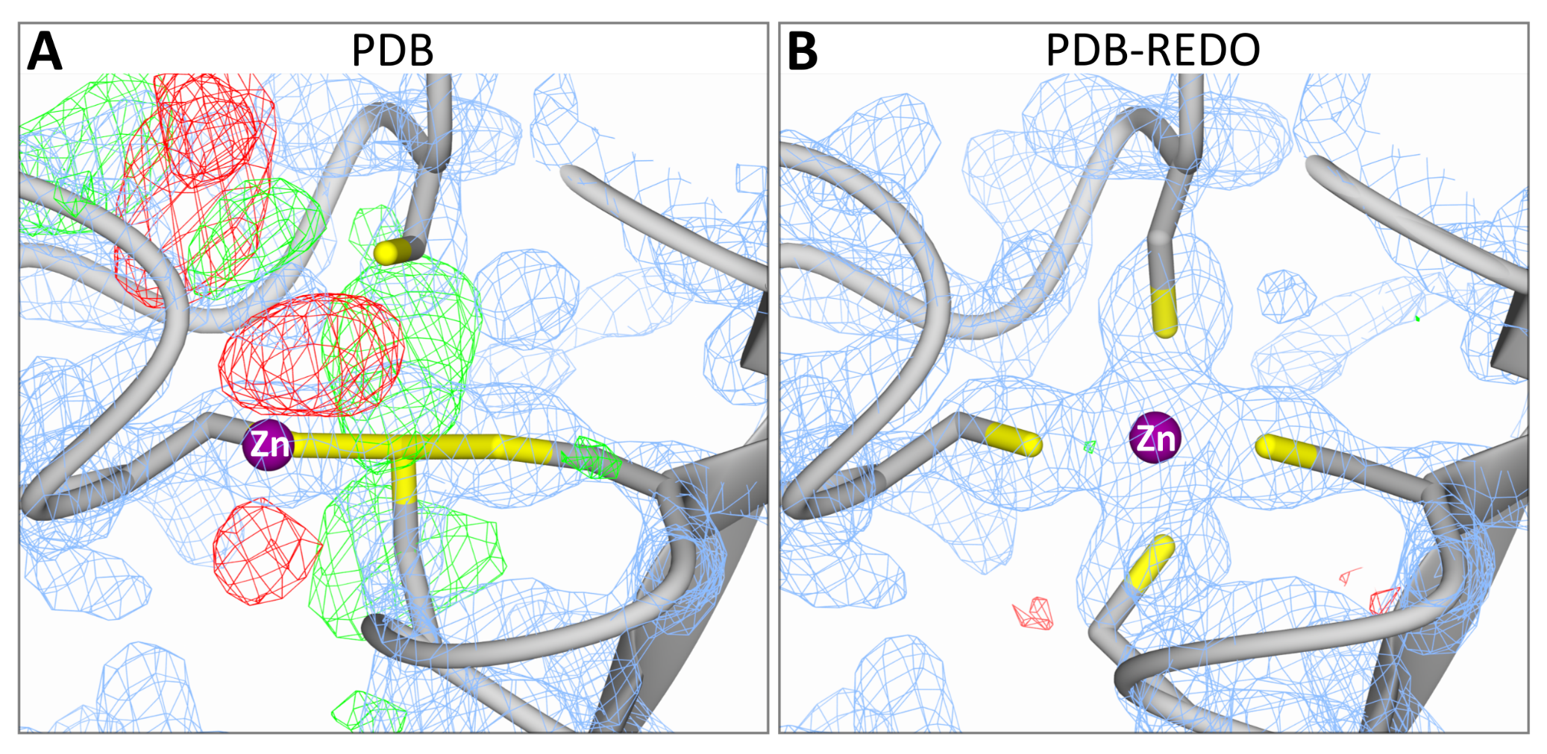
Added value of zinc restraints
Theory
Notes:
Resolution indirect measure of amount of data

Slide 23
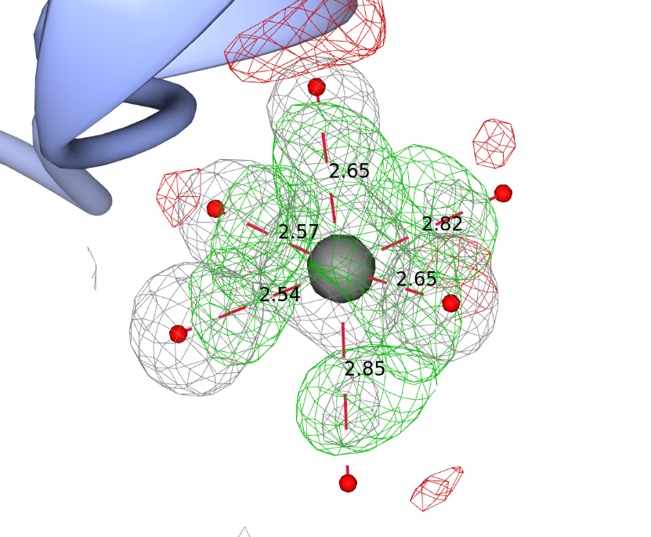
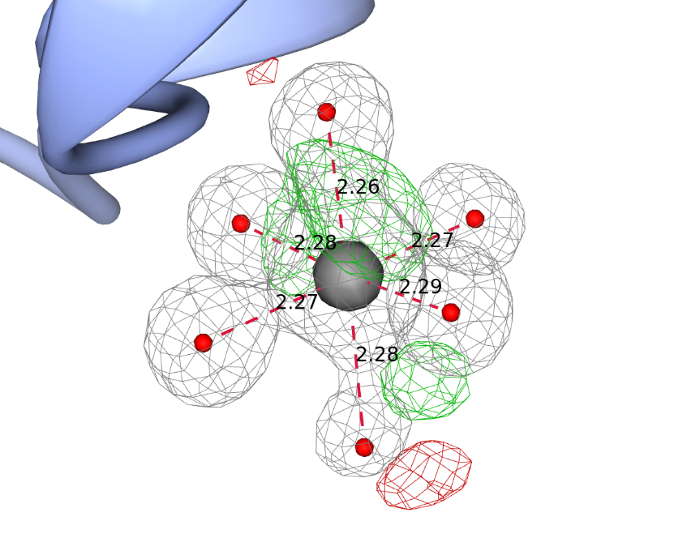
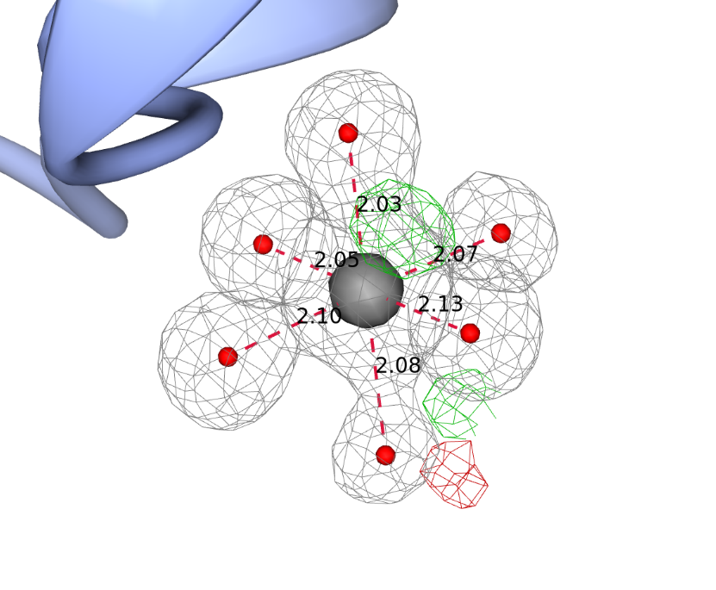
Added value of octahedral restraints
Magnesium site with sodium modelled becomes Mg-like
  Opposite can happen as well
PDB
PDB-REDO
PDB-REDO + platonyzer

Slide 24
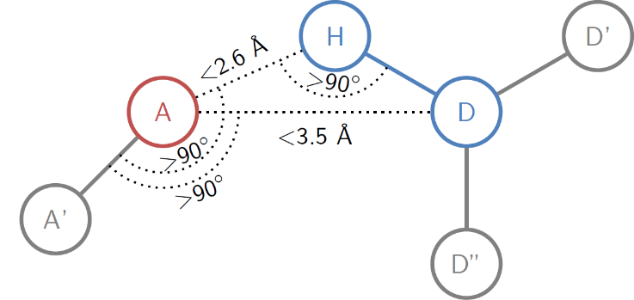
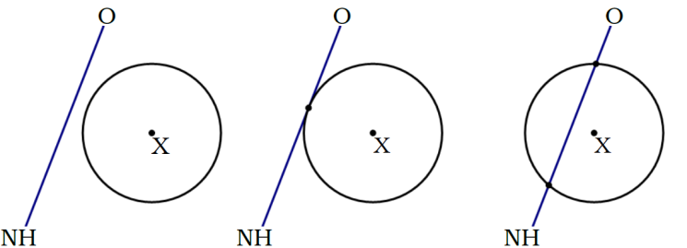
Homology-based H-bond restraints
H-bonds are real ‘long-distance’ interactions
  Can be used as distance restraints
Omnipresent in protein structures
  Enough extra information
  Side-chain H-bonds are very structure specific
We know what they should look like
  Detect and filter real H-bonds

Slide 25
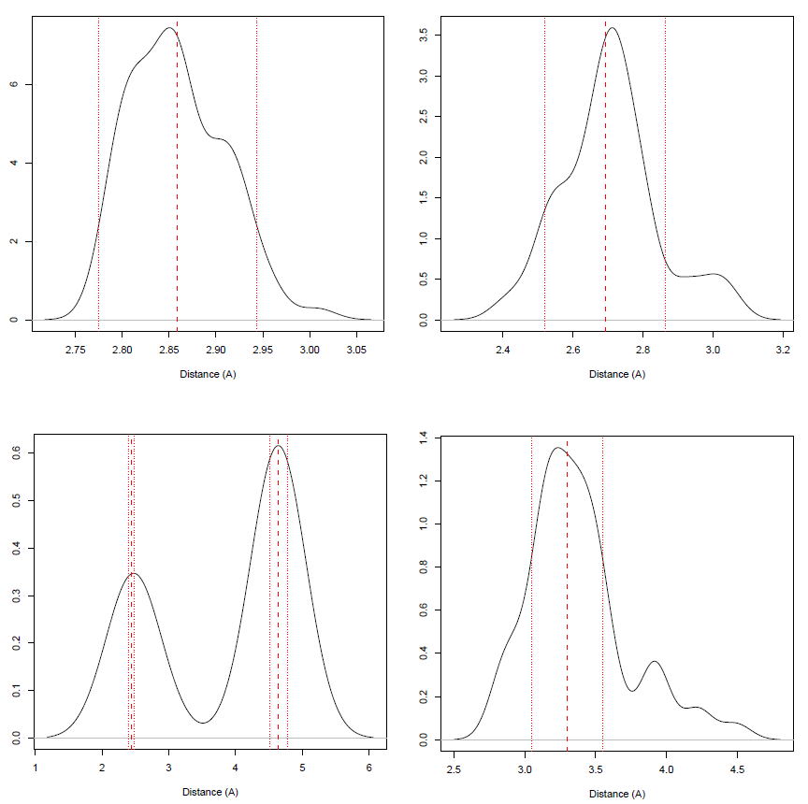
HODER: HOmology-DErivid Restraints
BLAST model sequence against PDB-REDO db
  Use models with sequence identity > 70% and resolution ≤ model
Find equivalent H-bonds in homologs
  Filter: same secondary structure
  Filter: same side-chain rotamer
If > 5 distances, fit target and SD
  Higher SD, lower relative restraint weight
Works for 82% of protein-protein H-bonds
  Fallback to 118 types of atom and secondary structure specific H-bond restraints
  Mined from 10k high quality structure models
    4 million observations

Slide 26
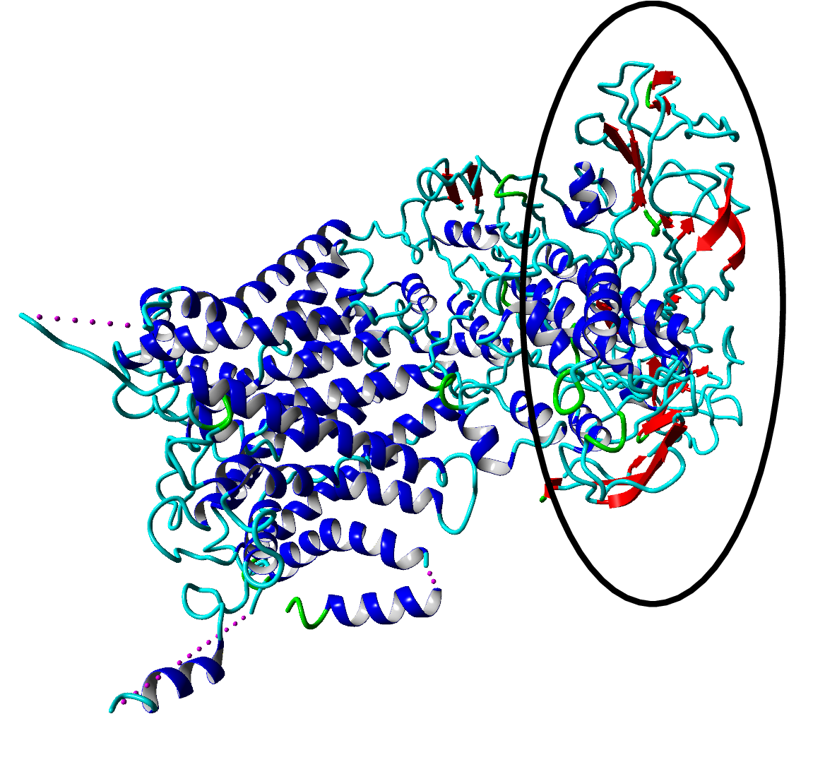
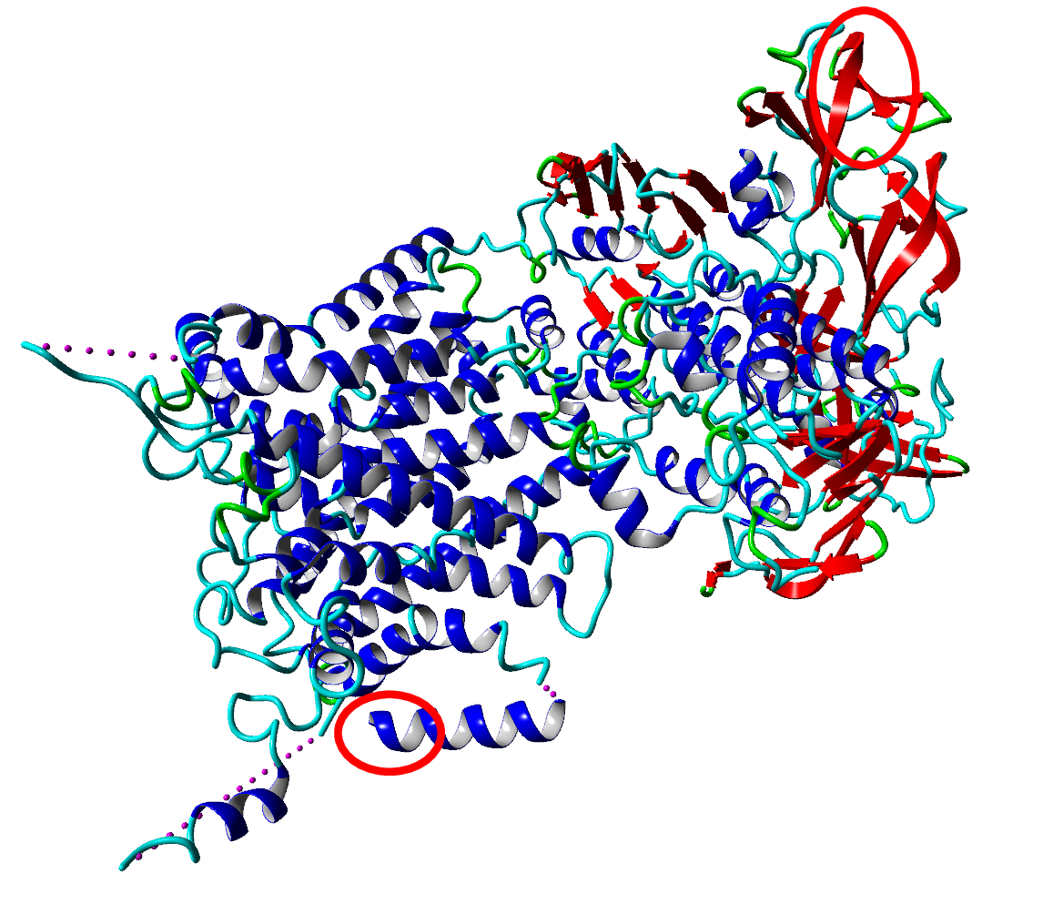
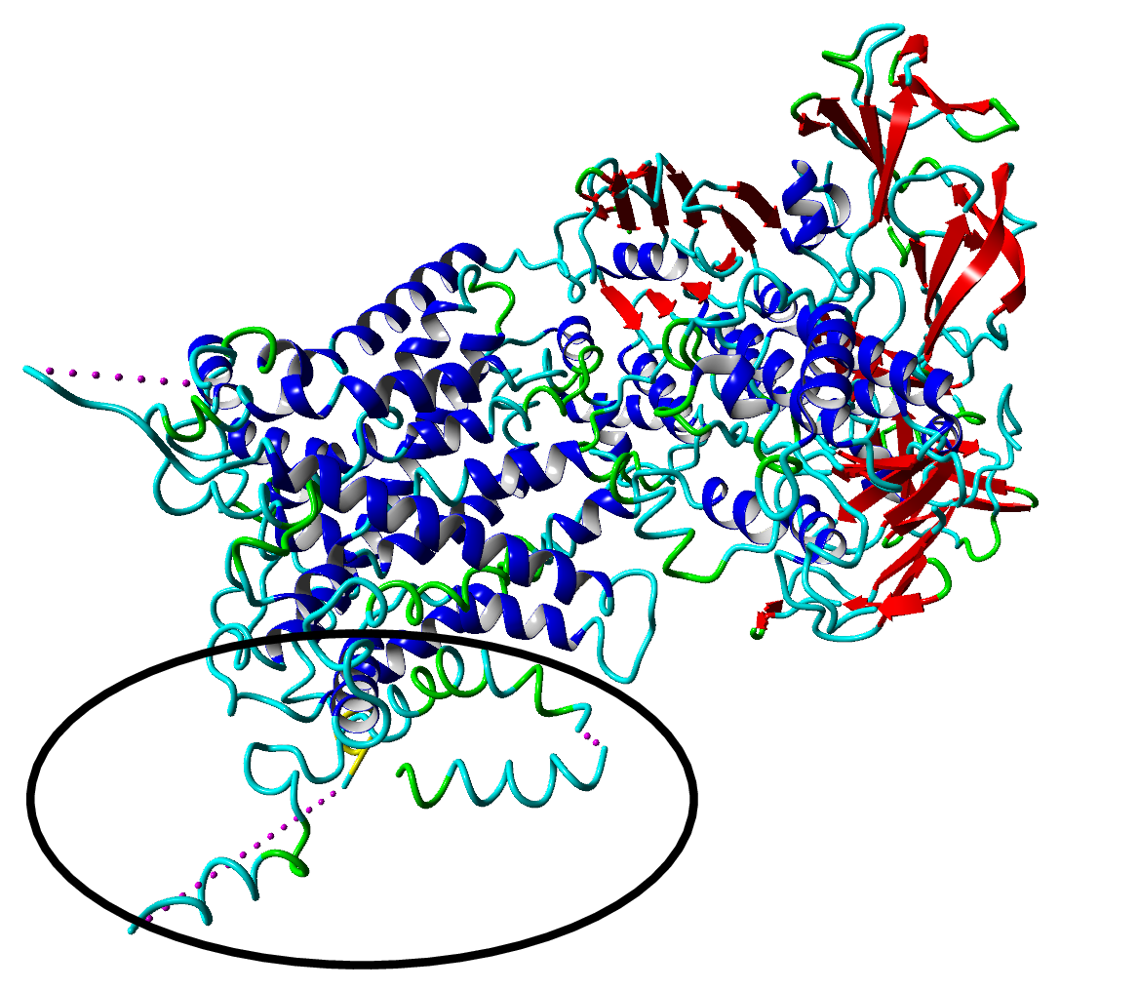
Added effect of homology restraints
Theory
E. Coli maltose transporter (3fh6, 4.5Å)
PDB-REDO new
PDB
PDB-REDO
Notes:
R-free 37.7 > 33.9

Slide 27
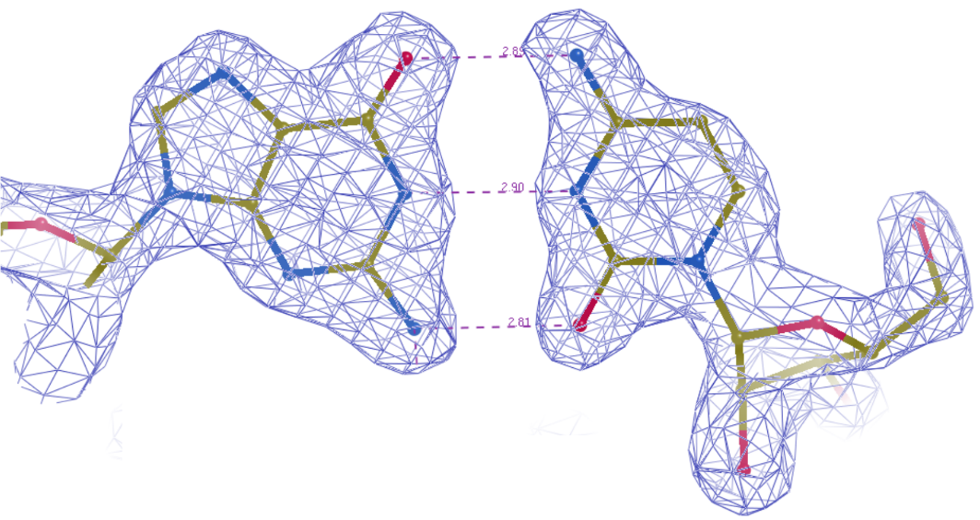
Nucleic acid features
Restraints for H-bond distances in WC base pairs
  Targets mined from high-res PDB-REDO entries
Base stacking restraints from LibG
Geometric validation
  Base pair geometry normality
    Z_{bpG} and rmsZ_{bpG}
  CONFAL scores from DNATCO

Slide 28
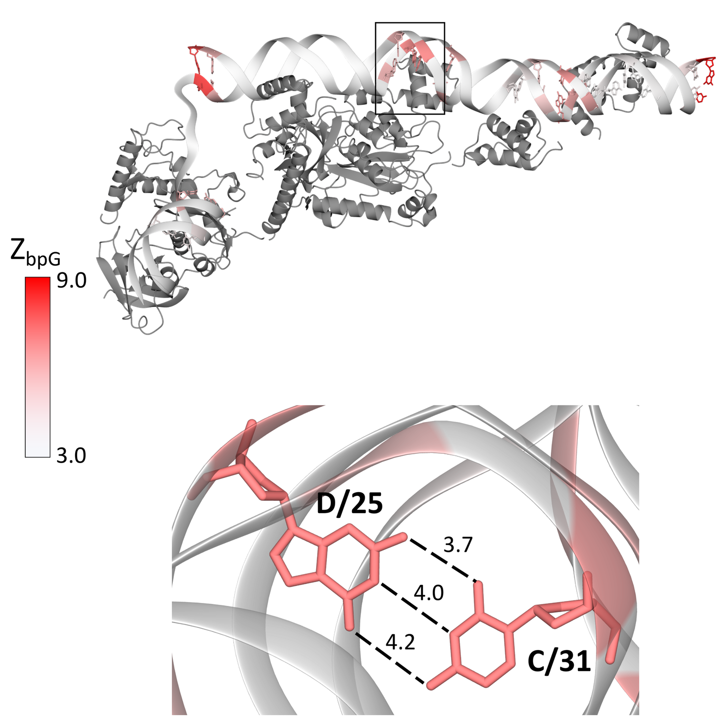
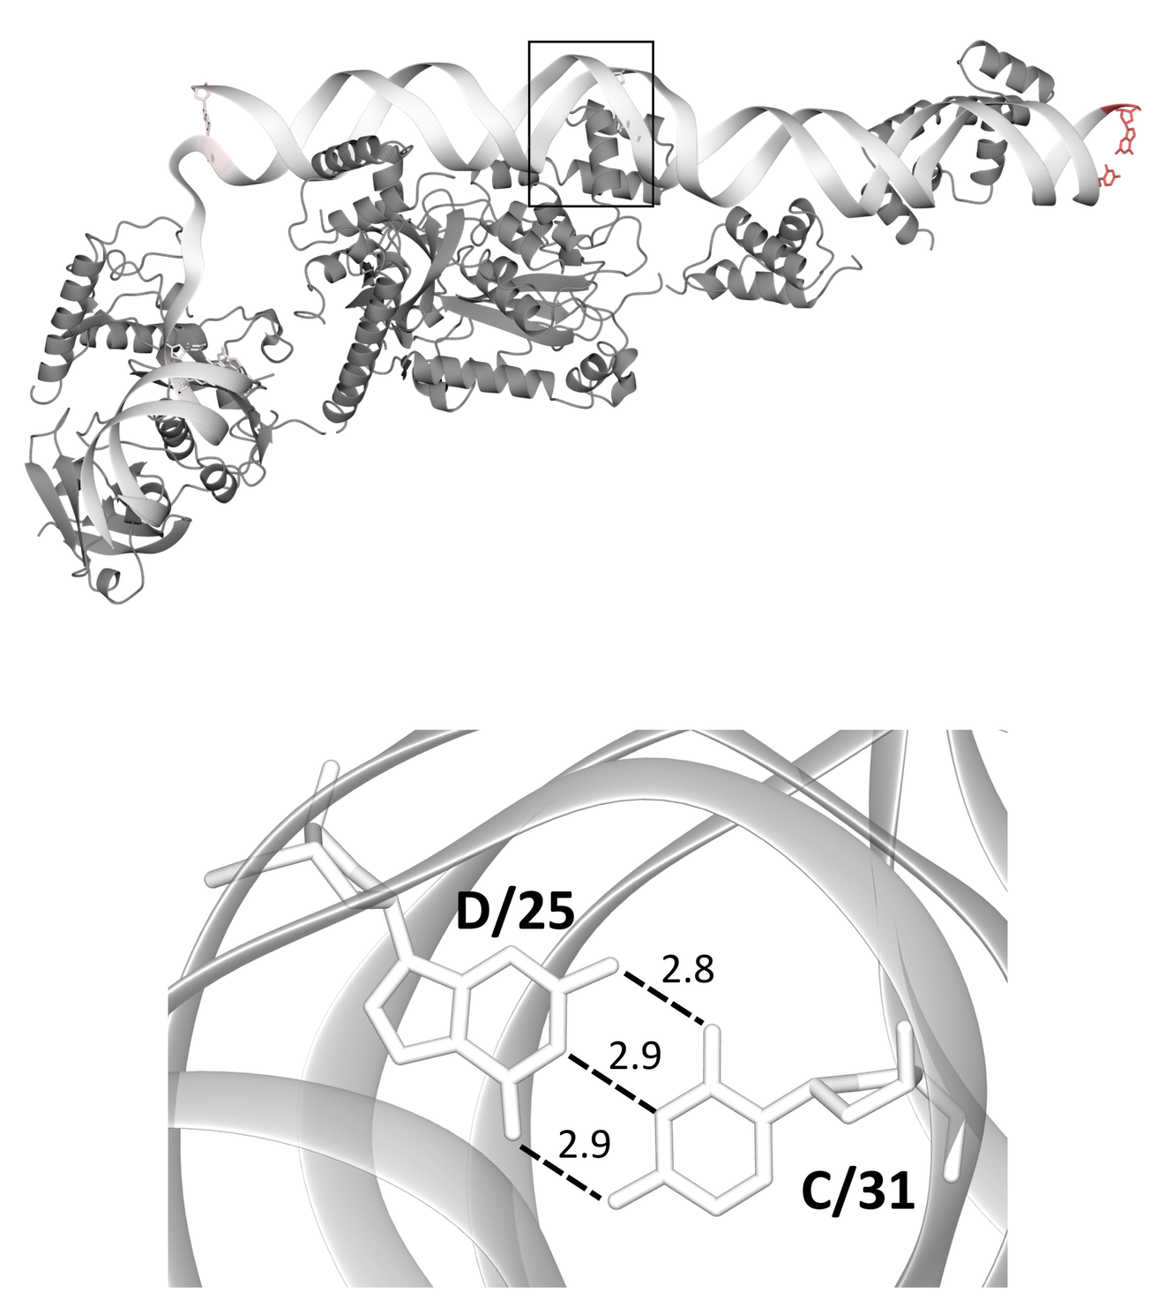
Effect of nucleic acid restraints
Theory
PDB
PDB-REDO
Notes:
R-free 37.7 > 33.9

Slide 29
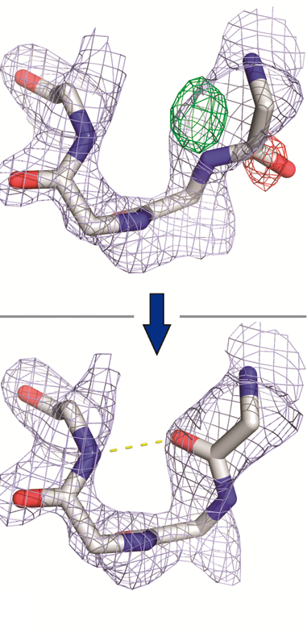
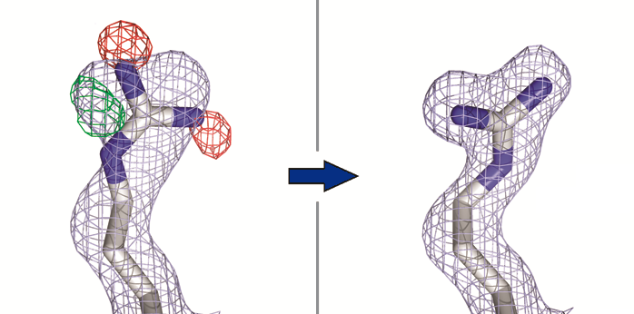
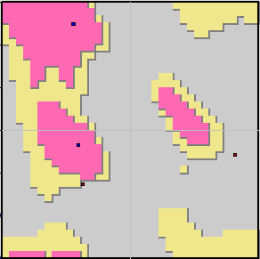
Model rebuilding
Methods
Peptide flipping:
  If a flip improves density fit and Ramachandran plot: accept flip
Side-chain rebuilding and completion:
  Add missing side-chains, rebuild existing ones, flip His/Asn/Gln if needed

Slide 30
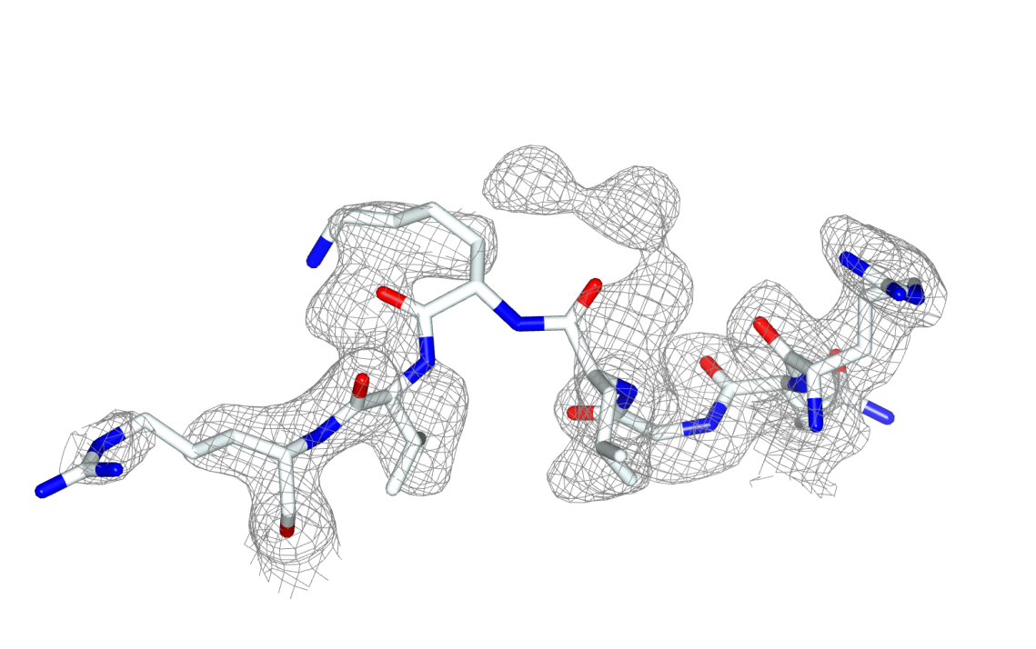
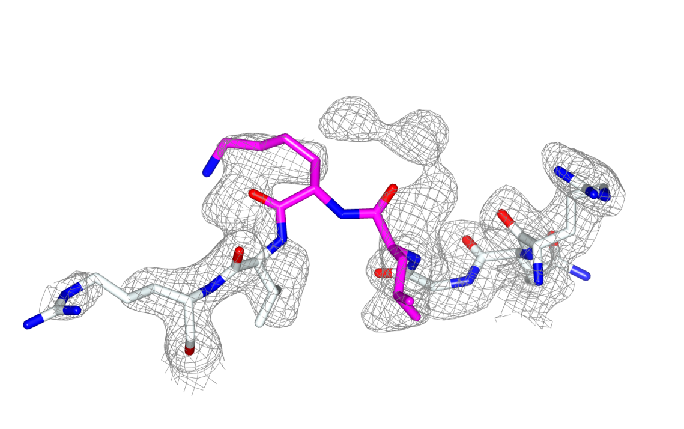
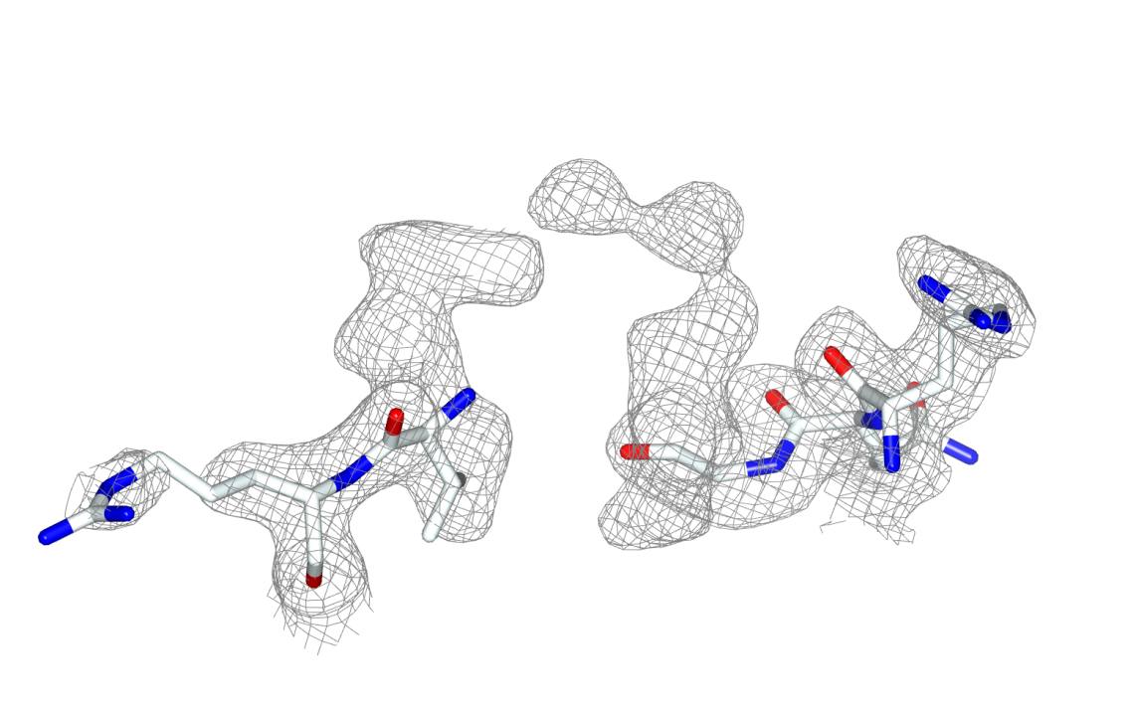
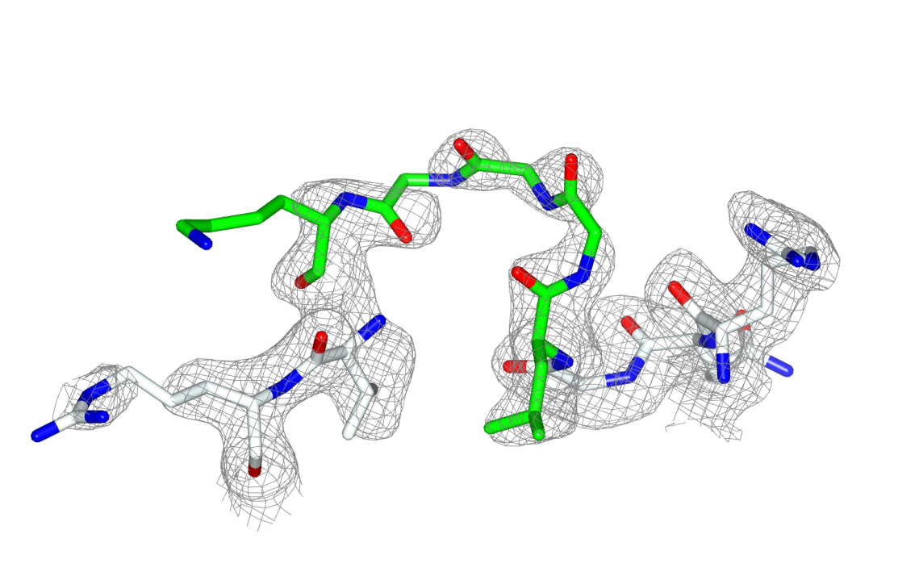
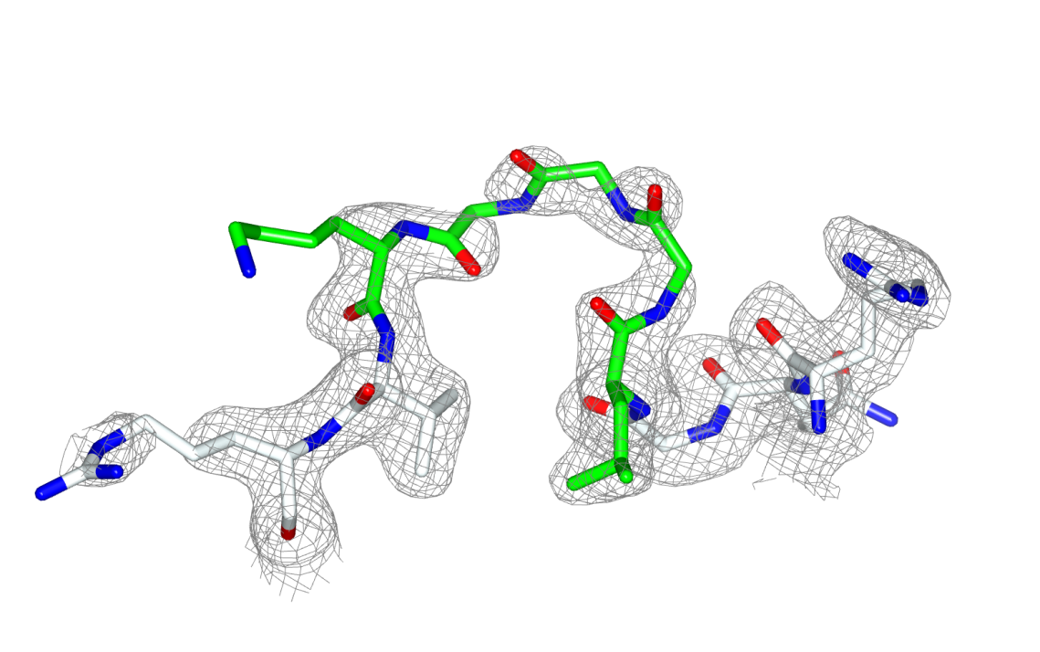
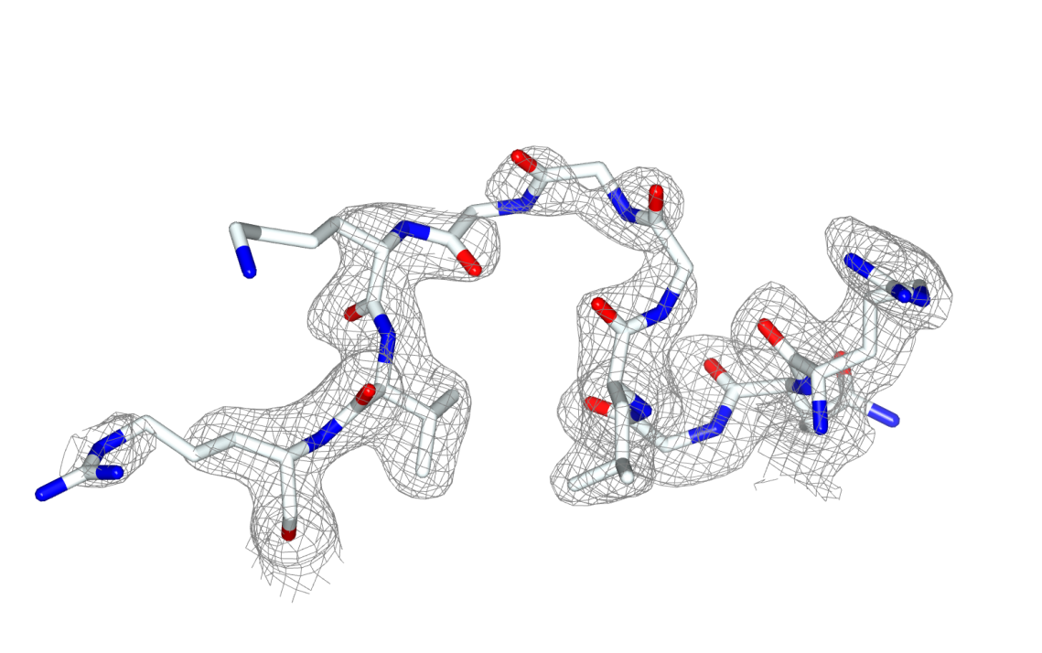
Homology-based loop building
Loopwhole adds missing loops by homology
Find missing loop based on sequence
Find homologous structures with the loop present
Prepare for loop transfer
For all homologous loops:
  Transplant the loop to target model
  Refine with coot-mini-rsr
Keep the best loop if it is good enough
  Filter on structural quality and map fit

Slide 31
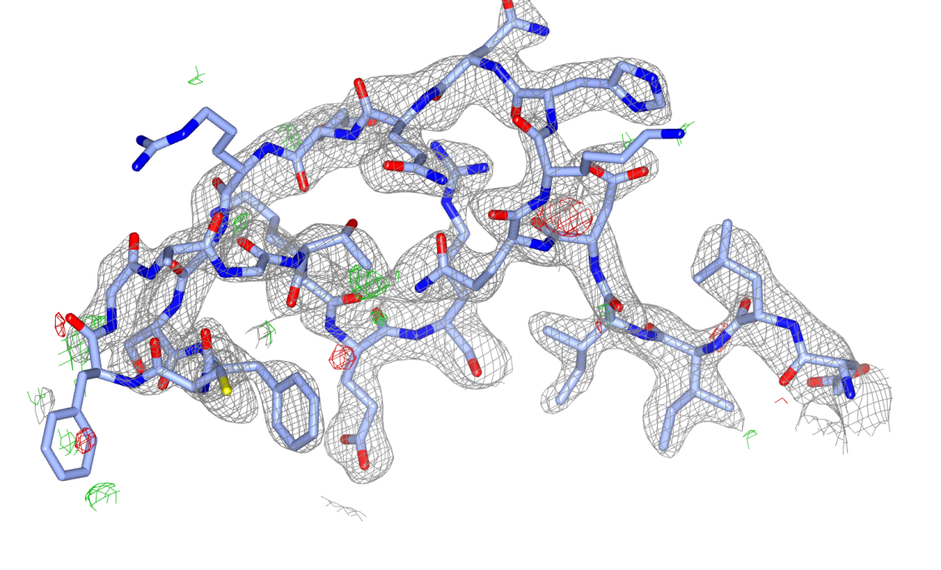
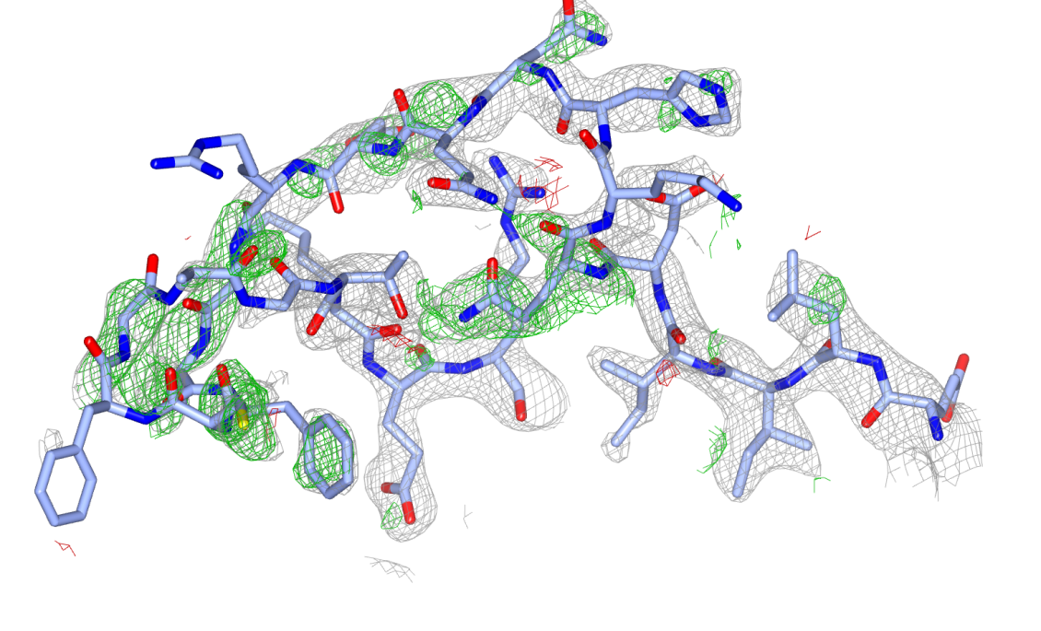
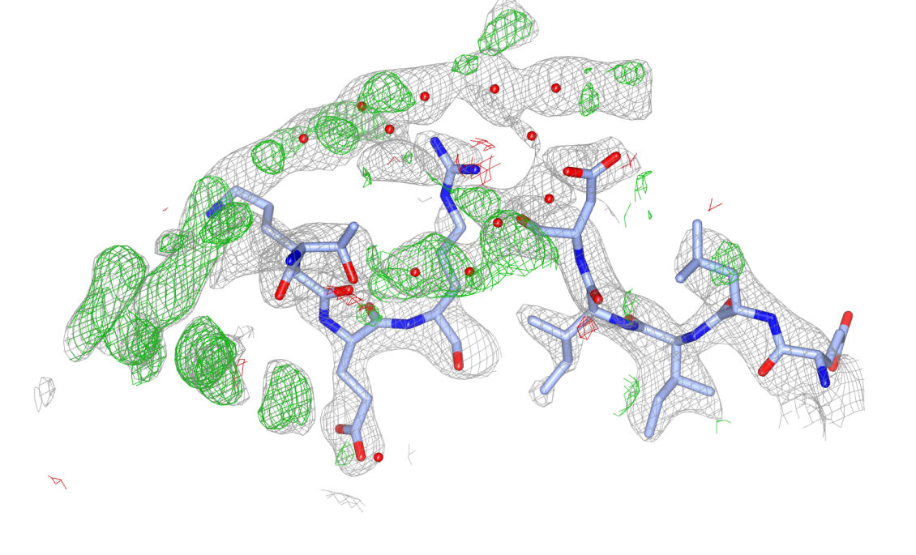
Real-life example
Theory
β-glucosidase (3abz, 2.2Å)
Notes:
3abz Beta-glucosidase (14 residues added)

Slide 32
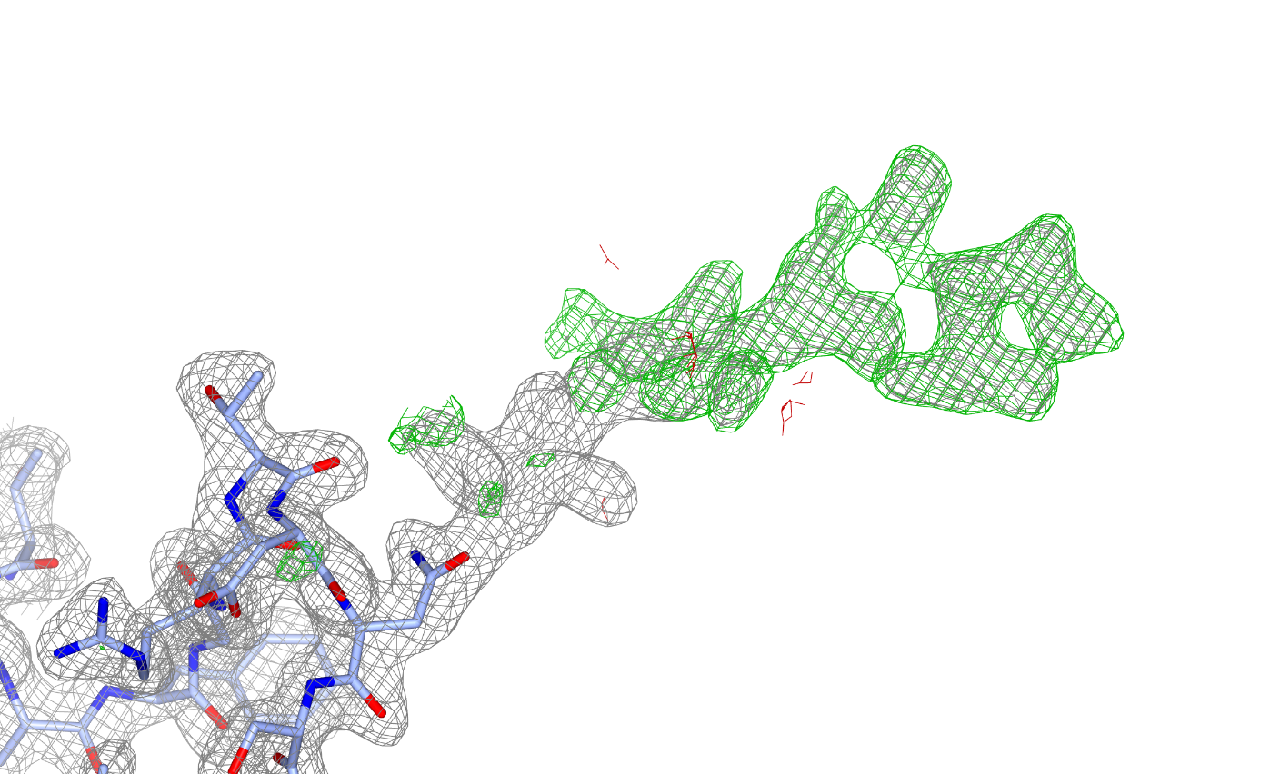





Automated N-glycan handling
Methods
Carbivore and COOT N-glycan building
Rebuild glycan trees with poor geometry
  Either biologically wrong sugars or residues marked by Privateer
Extend existing trees
  Delete waters that are in the way
Build trees from scratch
  Detect possible glycosylation sites from sequence (N-x-[TS])
Validate on density and geometry

Slide 33


Validation
Methods
Before-and-after scores for:
  Geometry: packing, rotamers, Ramachandran plot, H-bonds, bumps
  Density fit: per-residue RSR, RSCC, EDIAm and OPIA
  Ligands: density fit, interactions and Heat-of-Formation
 | PDB | REDO
RSCC | 0.91 | 0.96
Bumps | 22 | 5
H-bonds (kJ/mol) | -70 | -95
HoF (kJ/mol) | 11817 | 322

Slide 34


PDB-REDO model quality (n = 177k)

Slide 35

Herceptin – HER2 interface
After PDB-REDO:
R-free from 31.6% to 26.7%
  7σ improvement
Moved from 34th to the 99th quality percentile in MolProbity
Notes:
7 sigma improvement
Changes a30 A31 (herceptin) C602 C596 (HER2)
34th %-ile to
1n8z

Slide 36


Herceptin – HER2 interface
PDB
PDB-REDO
Notes:
7 sigma improvement
Changes a30 A31 (herceptin) C602 C596 (HER2)

Slide 37




Using PDB-REDO
Use CCP4 or pdb-redo.eu website
Password protected accounts
  Users from all over the world
Dashboard with previous jobs
  Summary sliders
Submit model, MTZ, sequence
  Restraints are optional
  7900 jobs run in 2024 so far

Slide 38
PDB-REDO output
Output
New model + new map coefficients
Tools to continue working on the structure model
  Optimised settings for refinement in REFMACAT
  Ready-made extra restraints
Description of model changes
  At the local and the global level
  Visually oriented: colour coding, plots, visualisation script for COOT

Slide 39


Output

Slide 40


Output

Slide 41
Using PDB-REDO is little work, but it helps you make better models

Slide 42
PDB deposition

Slide 43
PDB deposition
Share your model with the entire community
  The community paid for your research
Get credit for your work
Be comprehensive:
  Better description gives more useful model for others
Be ready:
  Finish your model
  Check it with the PDB validation server
  Fix real problems before starting the deposition

Slide 44
Preparing for PDB deposition
Use ‘Prepare files for deposition’ task in CCP4 cloud
  Takes final model, reflection data, target sequences, and if available logs from XIA2 and Aimless
Collect additional log files from software you used
  Data integration, scaling and merging, structure solving
Check reflection data: you should have all reflections + anomalous data
Collect experimental info
  Protein expression, sequence of construct, crystallisation conditions
  Diffraction experiment: how, where, and when
Other needed info
  Names and ORCID of depositors (not authors), funding information
  Title of model (not the title of the paper), release plan

Slide 45






PDB deposition
Register in the OneDep system
  You can use your ORCID
Upload your data and fill out the forms
  Hold model for publication, hide sequence and title if you want
  Pay extra attention to ligands
    Check the interpretation of your ligand
Check preliminary validation report
If no solvable issues, finish deposition

Slide 46

PDB annotation
You will get an email that your annotated model is ready
  You now have a PDBid for your model
Answer all questions that the annotator has
  If you disagree on something, explain why out think you are right
Once the annotation is done you get the final validation report
  A few outliers is not a problem
    PDB may use different targets for model geometry
    RSRZ outliers is a point of discussion
  You can still replace your model if there is something you need to fix
    Even after release

Slide 47
Publication

Slide 48
Things you should have
Science and stuff
A comprehensive ‘(supplemental) methods’ section
  Say what you did and which tools you used
  Be prepared to explain why you did certain things
A finished, deposited model in the PDB
A PDB validation report to submit with the manuscript
A comprehensive (supplemental) Table 1

Slide 49
Table 1 data
Different personal/journal/referee preferences
Model name and PDB identifier
Crystallographic description
  Space group and cell dimensions
  Overall and high-resolution shell data metrics
    Resolution, Rmerge, CC½, I/σI, completeness, multiplicity
  Do not give too many decimals
Refinement and model description
  Resolution, work/test reflections, R and R-free
  Atoms and average B-factors
    Make a sensible split of your model
Validation metrics
  Bond and angle rmsZ
  Ramachandran plot and rotamer favoured/outlier
    Also/alternatively the Z-scores
  MolProbity score and Clashscore (percentiles)

Slide 50
Summary
There are a lot of different validation programs and metrics
None of them are perfect; use common sense
No model is perfect; do the best you can; let PDB-REDO help
Always clearly describe what you did, and know why

Slide 51











Acknowledgements
Ida de Vries
Maarten Hekkelman
Bart van Beusekom
Krista Joosten
Anastassis Perrakis
RHPC facility
Gert Vriend
Jon Agirre
CCP4 developers
PDB annotators
Garib Murshudov
Paul Emsley
Rob Nichols
Keitaro Yamashita
Xiang-Lun Ju

